Slide 1
GEOGRAPHY
CH-7MANUFACTURING INDUSTRIES

Slide 2
IMPORTANCE OF MANUFACTURING INDUSTRIES

Slide 3
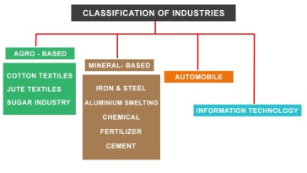
CLASSIFICATION OF INDUSTRIES

Slide 4
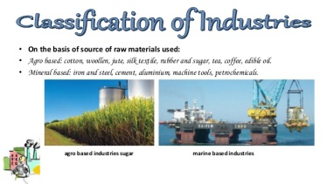
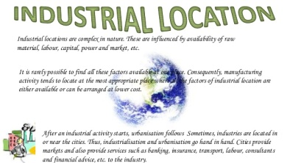
INDUSTRIAL LOCATION AND CLASSIFICATION

Slide 5
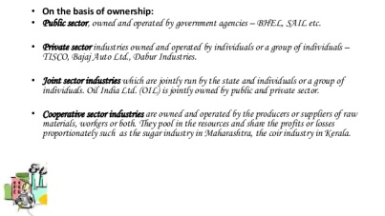
CAPITAL AND OWNERSHIP

Slide 6
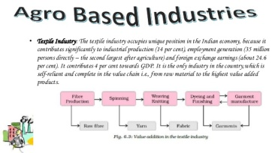
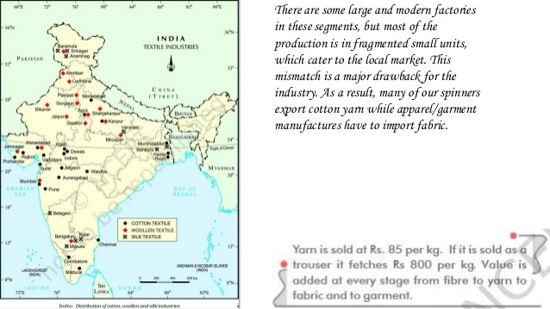
AGRO BASED INDUSTRIES

Slide 7
MINERAL BASED INDUSTRIES

Slide 8
PREPARED BY
KALYANI S
SNS ACADEMY

